Slide 1
Named Entity Recognition - UN Speech Transcripts
Aishwarya Sarkar (as99646), Aniket Patil (aap3788),
Anudeep Kumar Akkana (aa92799), Pratik Gawli (pbg397)

Slide 2
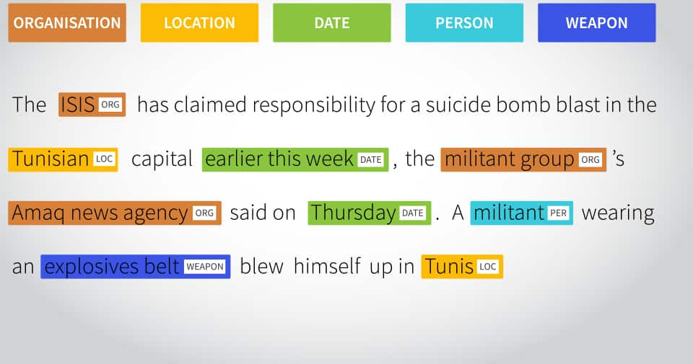
What is Named Entity Recognition?
Context
Dataset
Modeling
Results
Conclusion
NER is a task of extracting information from the sequence of words and sentences and classifying them into predefined categories such as person names, organizations, locations, medical codes, time expressions, quantities, monetary values, percentages, etc.
It is a subtask of information extraction.

Slide 3
Uses of Named Entity Recognition
Context
Dataset
Modeling
Results
Conclusion
Classifying content for news providers
Powering Content Recommendations
Entity Detection in Research Papers

Slide 4
UN NER Dataset Description
Context
Dataset
Modeling
Results
Conclusion
The dataset consists of speeches given at the United Nations General Assembly from 1993-2016 scraped from the website and then parsed
There are a total of 70 labeled documents consisting of transcribed speeches which 50 in the training and 20 in the test data
More than 50,000 tokens in the test data were manually tagged for Named Entity Recognition (O - Not a Named Entity; I-PER - Person; I-ORG - Organization; I-LOC - Location; I-MISC - Other Named Entity)

Slide 5
Hugging Face transformers
Context
Dataset
Modeling
Results
Conclusion
Hugging Face standardizes all the steps involved in training and using a language model. It has an API that allows easy access to pretrained models, datasets and tokenizing steps.
Model in use: DistilBERT (distilbert-base-uncased)
DistilBERT is a transformers model, smaller and faster than BERT, which was pretrained on the same corpus in a self-supervised fashion, using the BERT base model as a teacher.This model is uncased: it does not make a difference between english and English.
In DistilBERT, the size of a BERT model is reduced by 40% via knowledge distillation during the pre-training phase while 97% of its language understanding abilities is retained. It is also 60% faster.

Slide 6
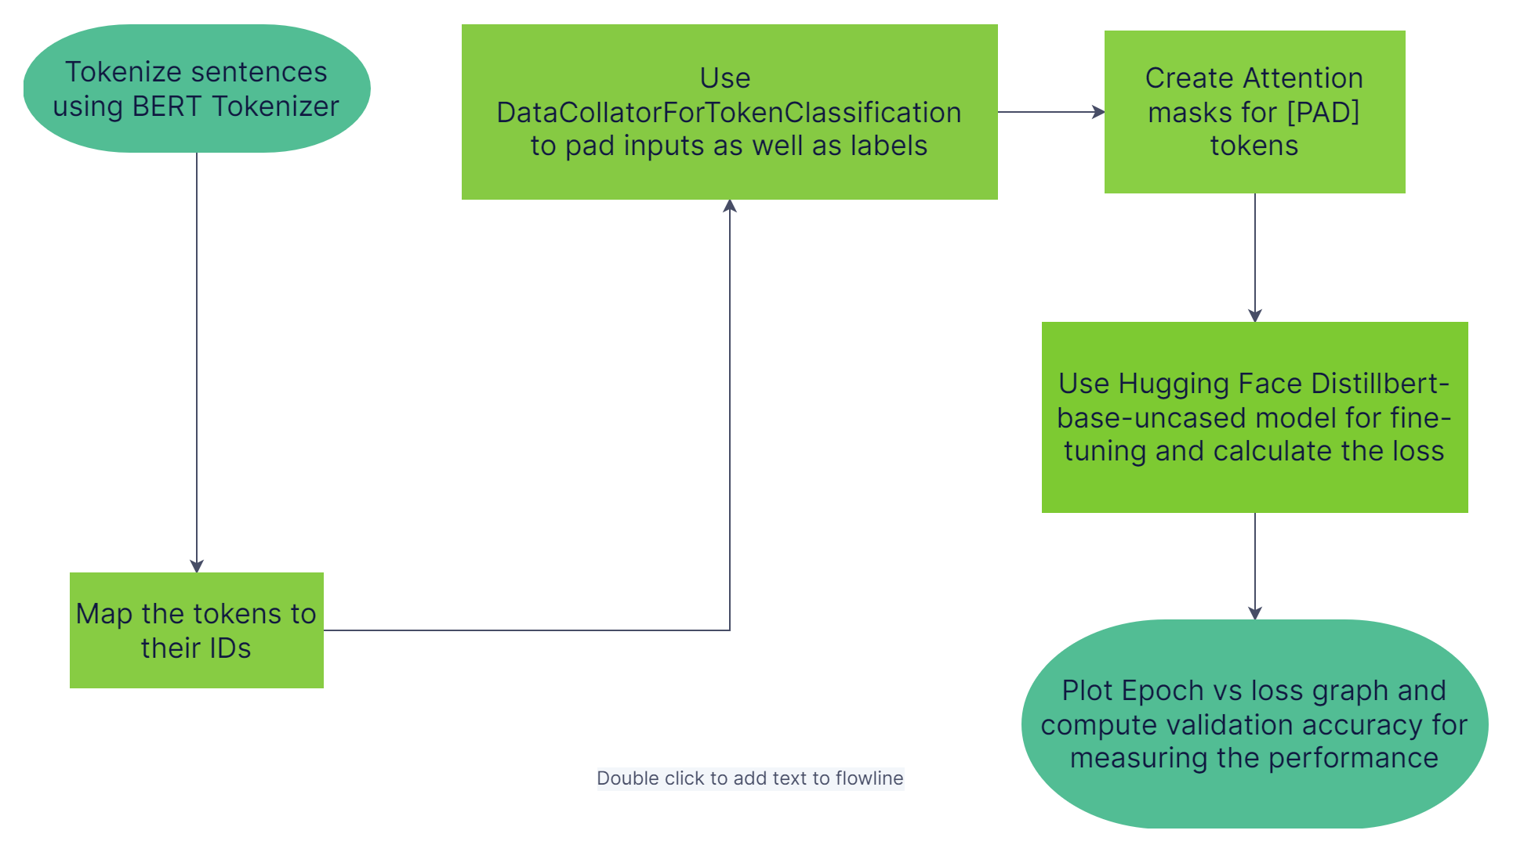
Process Flow Chart

Slide 7
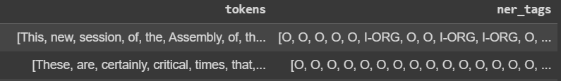
Tokenization and Prep-processing
Context
Dataset
Modeling
Results
Conclusion
Extract tokens and map tags from training dataset
Used BIO scheme of tagging
B: Token is start of a named entity (Used only when entity has multiple tokens)
I: Token is inside a named entity
O: Token is not a named entity
Above dataframe is mapped to distilbert-base-uncased tokenizer which creates attention masks to be used for fine-tuning in next steps

Slide 8
Fine-tuning & Hyperparameter opt.
Context
Dataset
Modeling
Results
Conclusion
Used distilbert-case-uncased model using “AutoModelTokenClassification” class
Used “DataCollatorForTokenClassification” for collating data for NER task
Used “Trainer” class for fine-tuning with UN transcripts
Optimize hyper-parameters using Ray Tune GridSearch
Batchsize, learning rate, epochs
Save optimized fine-tuned model
Load model for tokenization followed by entity recognition

Slide 9
Results
Context
Dataset
Modeling
Results
Conclusion
A named entity is correct only if it is an exact match of the corresponding entity in the data file
Metrics used to evaluate the NER model: Precision, Recall, F1 Score and Accuracy.
Accuracy: Accuracy is the proportion of correct predictions among the total number of cases processed.
Precision: Percentage of named entities found by the learning system that are correct.
Recall : Percentage of named entities present in the corpus that are found by the system.
F1 Score : The harmonic mean of the precision and recall.
Used the load_metric function from the datasets library in Hugging Face to load the seqeval metric

Slide 10
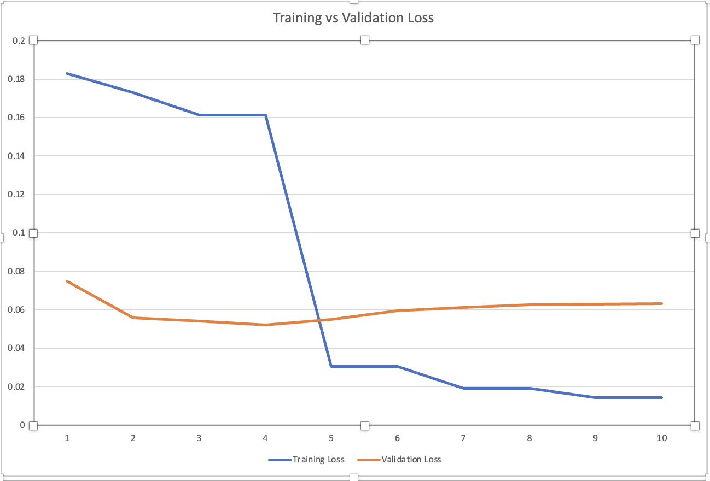
Results
Context
Dataset
Modeling
Results
Conclusion
Hyperparameters:
10 epochs
Batch size = 16
Learning rate=1e-5
Loss for training and validation sets:
Both training and validation losses are high at epoch 1(High Bias, Low variance)
Training loss decreases with increasing number of epochs, as expected
Validation loss lowest at the 4th Epoch, increases after that due to overfitting. (Low Bias, High Variance)

Slide 11
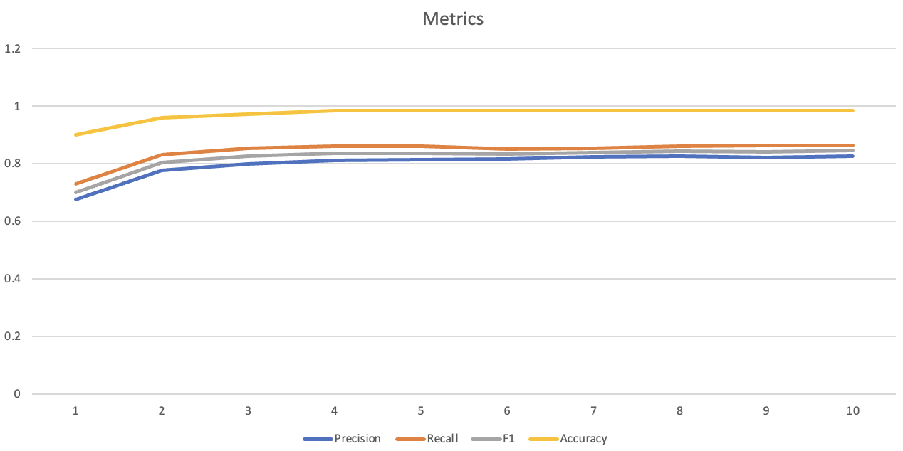
Results
Context
Dataset
Modeling
Results
Conclusion
Accuracy improves but is almost close to 1 throughout all the epochs
Precision, Recall and F1 score better metrics to evaluate NER model
Precision: Correctly identified Named Entities from the training set increases with number of epochs. Maximum: 0.8268
Recall: Percentage of named entities present in the corpus that are found follows a similar trajectory as Precision.0.864

Slide 12
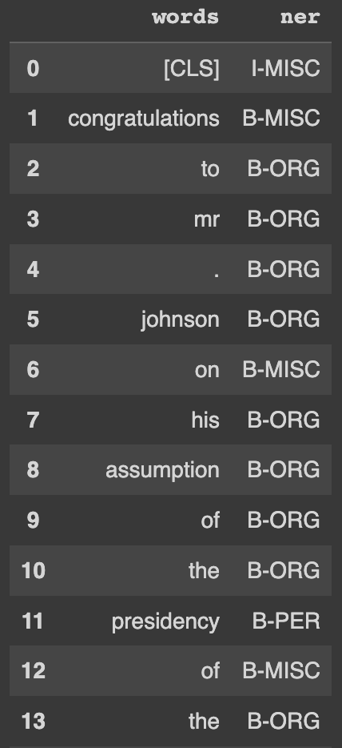
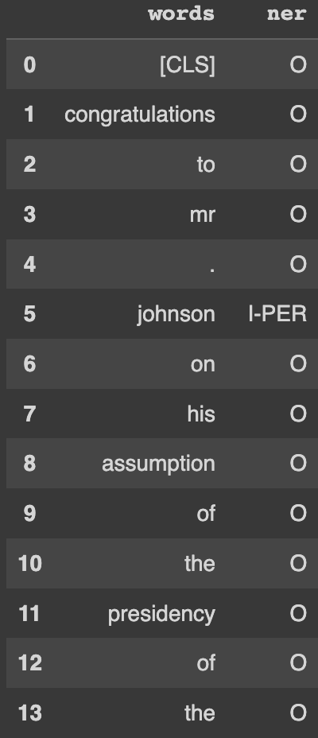
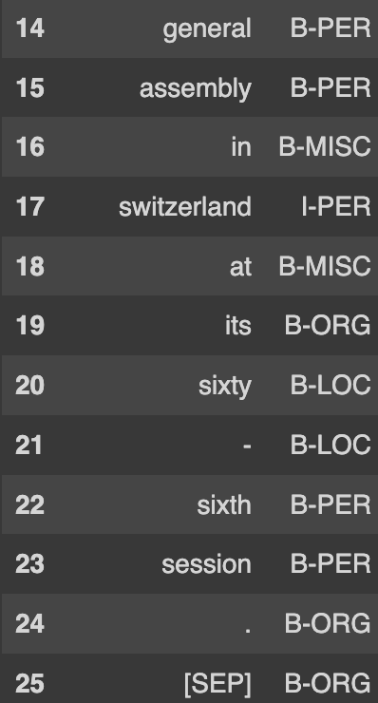
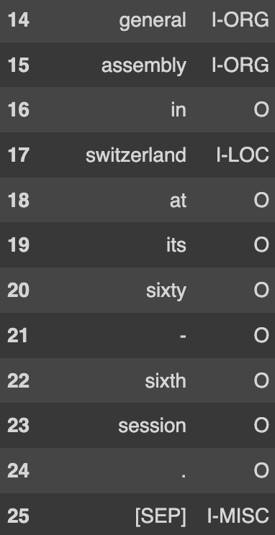
Results
Context
Dataset
Modeling
Results
Conclusion
Sample prediction
“Congratulations to Mr. Johnson on his assumption of the Presidency of the General Assembly in Switzerland at its sixty-sixth session.”
Without fine-tuning
With fine-tuning

Slide 13
Conclusion
Context
Dataset
Modeling
Results
Conclusion
Fine-tuned the Hugging Face NER model successfully with UN transcripts data to perform NER on the generated transcripts.
This model can be used in assisting UN speech transcript analysis in order to track the trends of which entities are most discussed during which time of the year to generate insights
Fine tuning can be done using other datasets as well such as sensitive information labels which can be used to censor confidential documents
Metrics such as Recall and Precision help evaluate the fine-tuning of the model better than the accuracy.

Slide 14
Thank you!

